Slide 1
Introduction to Child Protection
April 2023

Slide 2
Agenda
Opening and introductions (20 minutes)
What is Child Protection in Emergencies (15 minutes)
Child Protection Risks in an Emergency (20 minutes)
Prevention and Response to CPiE (30 minutes)
Q&A (10 minutes)
Action planning
Close

Slide 3
Child Protection in Emergency (CPiE) & Humanitarian Action
Notes:
Notes:

Slide 4
Learning Outcomes:
Develop a common understanding of what is CPIE
Identify serious threats to the life and wellbeing of children in emergencies
Identify key actions to prevent or respond to child protection risks

Slide 5
What is Child Protection?
Introduction to the concept in humanitarian action

Slide 6
Brainstorm ideas – 5 minutes plenary discussion

Slide 7
Child Protection definition
Prevention and Response to Exploitation, Violence, Abuse and Neglect (EVAN)
Note it is a sub-set of Child Rights Under the Convention of the Rights of the Child – we don’t look at all rights but specifically EVAN

Slide 8
CPIE is the prevention of and response to abuse, neglect, exploitation and violence against children in emergencies.
EVAN
Exploitation, violence, abuse and neglect
“An emergency response is triggered by a sudden natural or manmade disasters or by contextual analysis that demonstrates a substantial decline in children’s wellbeing that calls for extraordinary action”
Conflict and / or natural disaster
Rapid onset or slow onset or chronic
CPiE does not cover ALL the rights of the child but does originate in the CRC

Slide 9
Emergencies…
Child Protection in Emergencies
Exacerbate pre-existing risks & threats
Present new risks & threats
Undermine protective structures

Slide 10
Brainstorm
What are some examples of an Emergency (reference Myanmar)?
What are some examples of child protection risks in an emergency ?

Slide 11
Child Protection
Child Protection Risks were already prevalent in our context
Disasters Conflict and political situation, and covid have exacerbated these Child Protection concerns
Child Protection Concerns
Increase Violence against Children (including notable rise violence in the home and SGBV) especially in crowded conditions
Increase Child Labour
Lost and missing children (UASC)
Recruitment to armed forces
Increase Child Marriage
Separation from caregivers
Dangers and injuries
Increase exposure to trafficking and smuggling
Psychosocial distress and anxiety
Can you think of any more?
Notes:
5 minutes

Slide 12
Case study 1

Slide 13
CPiE involves specific activities by child protection actors, whether national or community-based, and/or by humanitarian staff and others supporting local capacities.
It includes, as a first step, guaranteeing that children receive all the necessary humanitarian assistance that is required for their safety and wellbeing.
It prioritizes the fulfilment of certain rights for children in emergencies, namely those that protect children against maltreatment and ensures their survival and wellbeing.
Notes:
Notes:

Slide 14
Brainstorm
What are some examples of how we can prevent child protection risks in Myanmar?
What are some examples of how we can respond to child protection risks in Myanmar?

Slide 15
Prevention and response
We use a “socio-ecological” model
This means we support
Child
Family
Community
Society
To address child protection risks
All these layers play a vital role in child protection

Slide 16
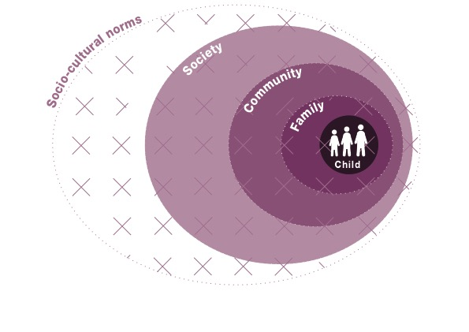
Pillar 3 – to develop adequate strategies

Slide 17
Some examples of activities to protect children
Group activities for child well being
E.G. Child friendly spaces, sports, play
Strengthening family and caregiving arrangements
Support to caregivers, positive parenting, social networks for caregivers, targeted support to caregiver, coordinate with GBV to prevent and respond to violence in the home, refer to case management where serious risks in HH
Community-level approaches
Different communities have their own child protection mechanisms
We can support by building on those mechanisms (after we understand them)

Slide 18
Some examples of activities to protect children continued
Case Management
Must be adequately trained
Individual support
Response based
Alternative care
Where children separated from caregivers
Prevention of separation is one of the key messages in emergency
Can be emergency care, community care, supported CHH
Family Tracing and Reunification - rapid
Mainstreaming
Work with other humanitarian actors to make sure they consider all the risks for children and address/mitigate them in their programs
Make sure other humanitarian actors have a phone number to call if they come across a possible CP risk

Slide 19
Case study 2

Slide 20
Q&A

Slide 21
Action Planning
Identify the risks
Identify how to prevent risks
Identify how to respond to CP cases
Lay these out in a table, make sure to mention WHO is responsible and timeframes for the actions!

Slide 22
Where to get support
Child Protection Minimum Standards in Humanitarian Settings 2019 (book)
https://alliancecpha.org/en
https://www.cpaor.net/
Call UNICEF ☺
Contact your CP AoR coordinator (krhayes@unicef.org)
Talk to communities and ask their CP mechanisms – these are the most effective and sustainable!

Slide 23
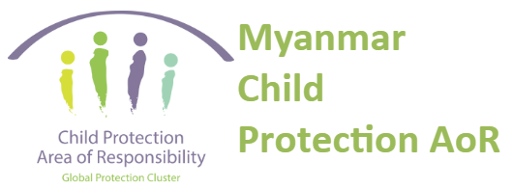
Let’s work together to strengthen coordination in Myanmar
“Coming together is a beginning; Keeping together is progress; Working together is success. ...”
THANK YOU!

